Slide 1
Starting out right with Xamarin
2018 EDITION
and other useful tips, tricks and resources
p.s. still just my opinion
RYAN DAVIS
QUEENSLAND C# MOBILE DEVELOPERS MEETUP
2018 09 25

Slide 2
whoami
Ryan Davis
Professional Mobile LINQPad Developer
Blog: ryandavis.io
Twitter: @rdavis_au
Github: @rdavisau
essential-interfaces – use DI/mocking with Xamarin.Essentials
jsondatacontext-linqpad – json data context driver for LINQPad
sockets-for-pcl, sockethelpers – socket comms in a PCL (today you should use netstandard sockets why are you all still installing this)

Slide 3
to cover
File -> New
Mobile principles to live by
Pop Quiz – your first big questions
Spotlight on some useful libraries
Roundup of resources.

Slide 4
-= mobile principles to live by =-
#1
know
platform
love thy neighbour

Slide 5


why Xamarin, again?
(yeah this list isn’t really MECE)
Xamarin because:
Write code in powerful, expressive languages
Take advantage of the .NET platform and ecosystem
TARGET ALL THE PLATFORMS!!
Share as much code as we can
Avoid Java and Objective-C and swift
Don’t want to learn about the native platforms.

Slide 6
not all mobile platforms are created equal
Xamarin is not designed to relieve you of the need to understand the underlying platform:
Android, iOS and UWP differ on many levels – UI, app lifecycle, sandboxing
Each platform might be more or less suited to a task or paradigm
Xamarin.Forms abstracts some of these platform variations, some of the time.

Slide 7

fortunately, we can make use of native docs
Xamarin’s iOS/Android frameworks are C# idiomatic, but otherwise near identical to native ObjC/Swift/Java counterparts
A book or course targeting iOS or Android native is still relevant, especially for frameworks like UIKit and CoreAnimation
Tutorials and documentation are easily adapted
The balance of swift – objc samples has tipped over the last couple of years
Probably the biggest deviation from native API naming:
→ GetCell(,)
- tableView:cellForRowAtIndexPath:
NATIVE iOS
XAMARIN iOS

Slide 8
-= mobile principles to live by =-
#2
cross-platform ^
begin with the end in mind

Slide 9
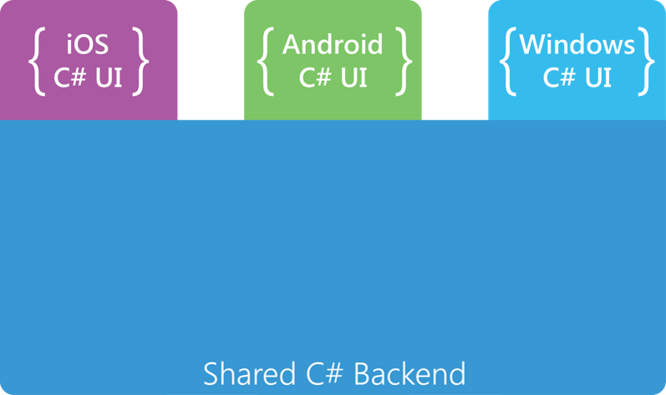
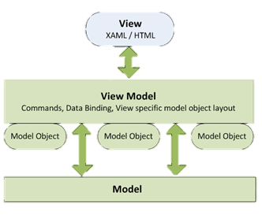
Forms or otherwise, MVVM is a safe bet
The components of MVVM map closely to the original code sharing architecture in a Xamarin app, and the ecosystem has evolved around that.
Native Project
Native Project
Native Project
Portable Class Library
From a Xamarin Presentation
From a google image result for MVVM

Slide 10
go MVVM with netstandard from the beginning
- Netstandard
Xf first
CI first
(even if you focus on a single platform first)
Keeping your viewmodels in the core project and your views in native projects* encourages Good HabitsTM
You cannot accidentally use platform-specific and non-netstandard APIs
You cleanly separate your viewmodel and views, and your code goes into the viewmodel by default.
* In Xamarin.Forms projects, a dedicated UI project gives you the same separation and benefits

Slide 11
-= mobile principles to live by =-
#3
dependencies
keep your liabilities closer

Slide 12
mobile moves fast, libraries age faster
Xamarin lends itself to libraries and abstractions, and there are many
Libraries can got stale for lots of reasons, some particular to the Xamarin/Mobile
Mobile itself moves quickly and changes frequently – something that works today may be deprecated or disallowed in a year’s time.

Slide 13
think carefully about adding dependencies
When the next android SDK deprecates features in your dependencies, or you want to bump your target version, what will you do if your libraries haven’t been updated?
If your dependencies move to newer API versions before you are ready, how can you incorporate important bugfixes or new features?
If you discover a bug in an abandoned library that you’re already shipping, how will you prevent it from affecting your users?

Slide 14
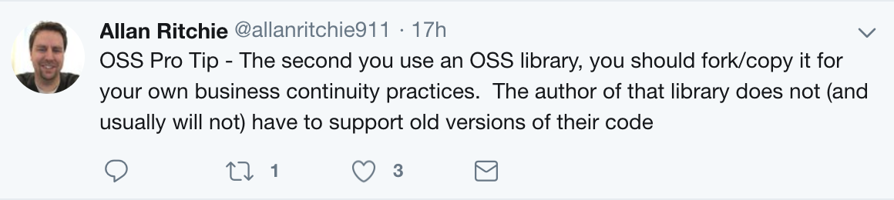
With OSS, we have options
A private NuGet feed to host builds from forks can help out in a pinch
e.g. uptarget or downtarget a dependency
Incorporate a bugfix that the maintainer hasn’t merged
Add InternalsVisibleTo(“yourproject”) a library (if you are feeling brave)
Consider how to best contribute fixes or changes back to mainline repos.

Slide 15
-= mobile principles to live by =-
#4
win friends and influence people
aka. get involved in the community

Slide 16
Xamarin has a great core community
For newcomers, it can be hard to know what’s out there, which libraries are reliable, etc. it can help to start following the work of others
Twitter is a popular platform amongst Xamarin and .NET developers
https://twitter.com/kwlothrop/lists/xamarin-mvps
For a good summary of what’s happening, subscribe to the Weekly Xamarin Newsletter

Slide 17
POP QUIZ
Answering the tough questions

Slide 18
Q1: your next cross platform mobile app

Slide 19


Q1: your next cross platform mobile app
NATIVE
WEB
VS

Slide 20

Q2: To Share UI, or not to Share UI
Xamarin
Xamarin.Forms
or

Slide 21
Q2: To Share UI, or not to Share UI
Xamarin
Xamarin.Forms
or
Forms has been improving steadily over the years and is now open source
You can do nice UIs with Forms: jsuarezruiz/xamarin-forms-goodlooking-UI
Forms Embedding is a Great Thing Which You Should Definitely Use
see Alex Dunn’s posts for some techniques (iOS, Droid)

Slide 22




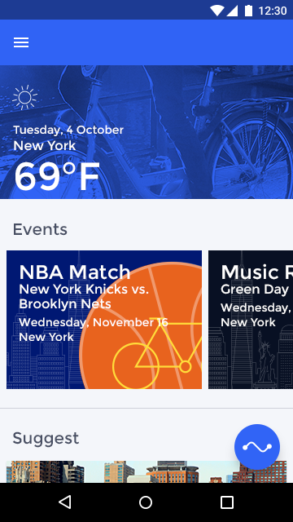
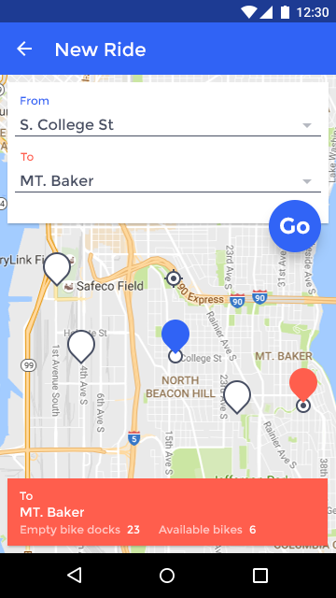
Q2: To Share UI, or not to Share UI
jsuarezruiz/xamarin-forms-goodlooking-UI
SmartHotel
BikeSharing

Slide 23
Q2: To Share UI, or not to Share UI
Xamarin
Xamarin.Forms
or
If you want flexibility: use a native shell with first class support for embedding
Keep Xamarin.Forms off the startup path
Full native control over screen transitions and exterior elements
Use viewmodel-first navigation and centralise your forms<->native smarts there (including XF initialisation)
Even the most UI intensive apps can likely benefit from a few forms pages

Slide 24
Q3: <UI /> or new UI();
XAML/Designer
Coded UI
or

Slide 25
Q3: <UI /> or new UI();
XAML/Designer
Coded UI
or
But either is cool

Slide 26
Q3: <UI /> or new UI();
XAML/Designer
Coded UI
or
But either is cool

Slide 27

Q3: <UI /> or new UI(); - iOS
XAML/Designer
Coded UI
Storyboards
Single file containing screens + transitions
Many ‘new’ features including static tableview content and prototype cells
Source control nightmare
XIBs
File per view – easy reuse, source control
‘New’ features not supported
Both
Easy visualisation, easy? constraints
Difficult to model dynamic layouts
Coded UI
“Anything is possible” – dynamic layouts, subclassing/reuse
No magic – you control how and when your view is created
Writing constraints in code can be arduous – DSLs (e.g. FluentLayout, EasyLayout+) help
No design-time/preview unless you use something like Continuous
I like coded

Slide 28
Q3: <UI /> or new UI(); - Android
XAML/Designer
Coded UI
AXML
The ‘right’ way to do Android UI
If you have trouble with the Xamarin.Android designer you can use the Android Studio one.
Coded UI
Not impossible, just not advisable
Some discussion here

Slide 29
Q3: <UI /> or new UI(); - Xamarin.Forms
XAML/Designer
Coded UI
XAML
Good tooling support in wrt previewer and live reloader.
On VS4Mac, Mfractor adds many significant QoL and productivity enhancements to the XAML experience in particular
XF developer mindshare tends towards XAML-based views
Coded UI
“Anything is possible”
Some constructs can be more verbose to specify in code
Some constructs can be less verbose to specify in code
No design-time/preview unless you use something like Continuous
Use CSharpForMarkup and thank Vincent later
I like coded

Slide 30

Q4: Which IDE
Visual Studio
VS4Mac
VS
Resharper
UWP
Generally better editor experience (IMO)
Consolidate NuGet packages
MFractor
Better iOS experience – designer, build/deploy
Some features come to mac later than win
I use both

Slide 31
Q5: Your dev machine and you
Parallels
Bootcamp
VS
ESX
Hyper-V
VS

Slide 32

Q5: Your dev machine and you
The true challenge of cross platform:
You need a Mac to build/run iOS apps
You need to be running Windows + Hyper-V to run the UWP device emulator
Android is chill and runs everywhere, thanks buddy
What can we do?
If you want to keep your options open, a Mac is a safe expensive bet
Use Bootcamp, you can boot Windows direct or use Parallels/VMWare from OSX (Parallels seems to perform best, this result has been consistent for several releases now)
If you’re brave, you can also boot your OSX partition in VMWare when running in Bootcamp: https://pigiuz.wordpress.com/2013/11/22/how-to-make-a-vm-boot-your-osx-partition-from-windows/
hey NBD

Slide 33


Spotlight
on some cool libraries
I ran out of time there are only 2

Slide 34
how to use HttpClient to query a JSON API
Reconsider.
Step 1:

Slide 35
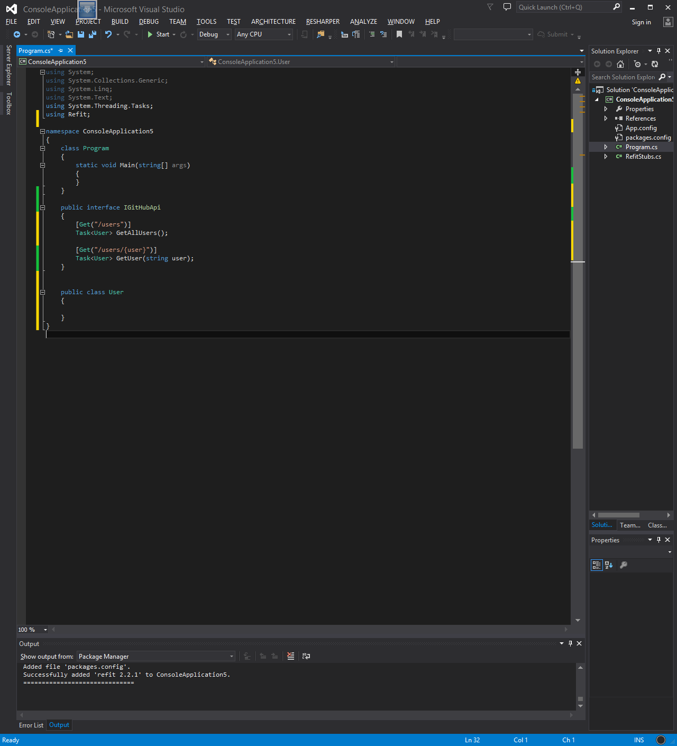
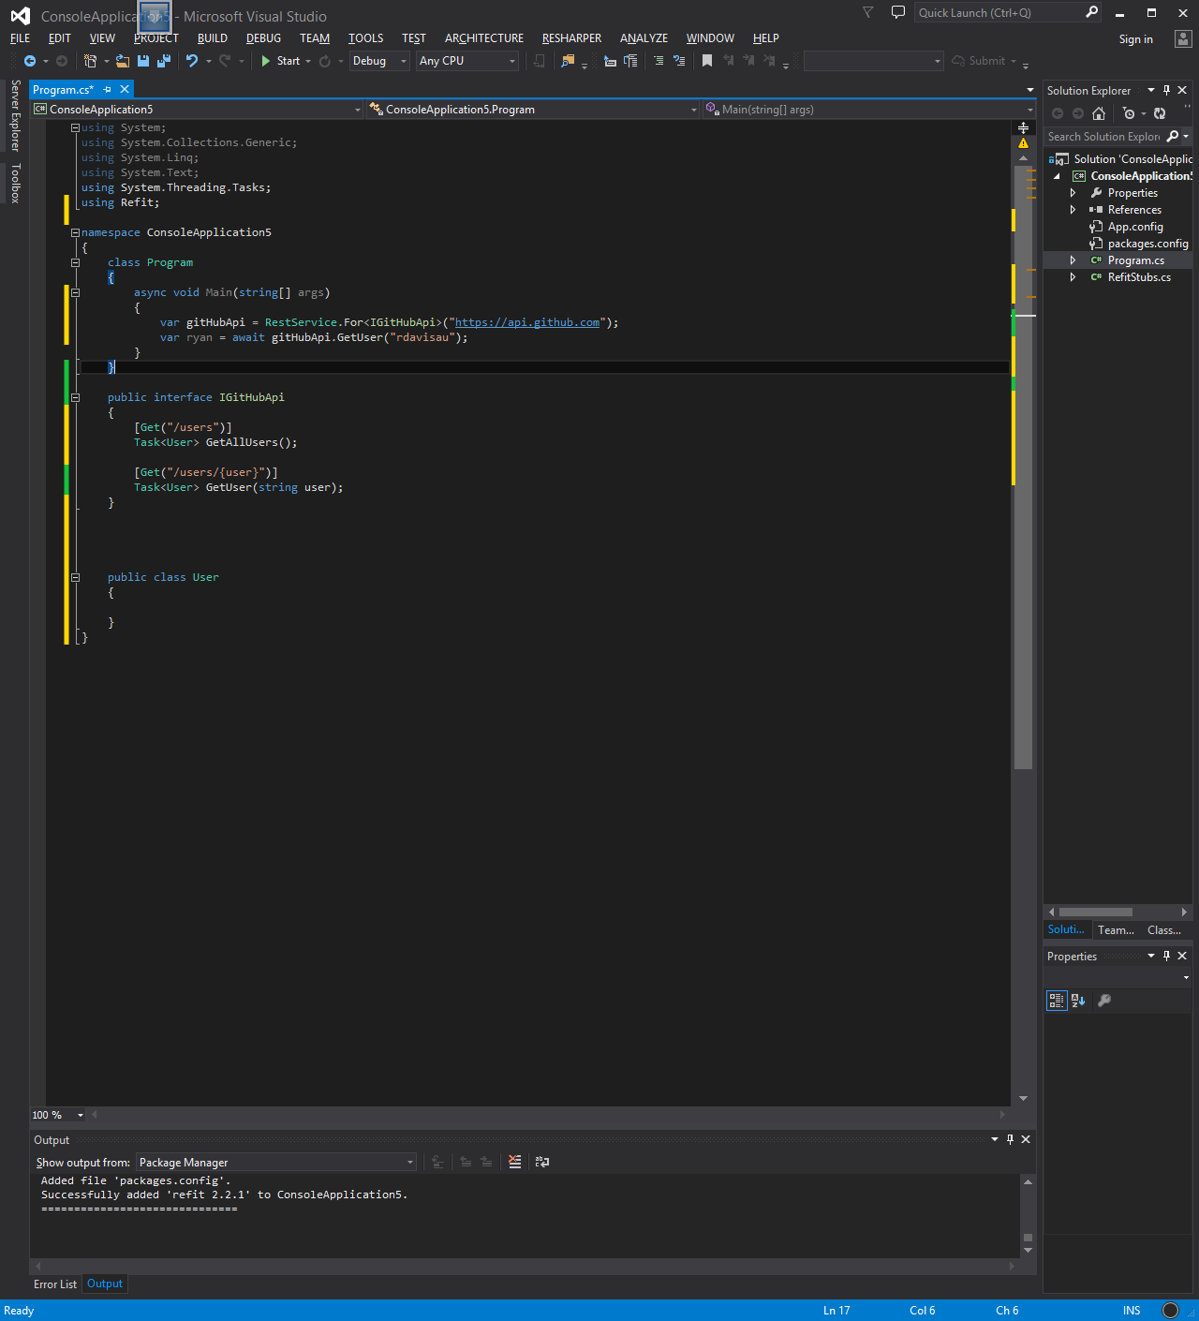
hello Refit
Refit gives you automatic type-safe api client generation
Create an interface for your API, annotated with verb and URL stem
Type-safe API methods, async, (de)serialization come for free!
Supports all the best verbs, body parameters, authentication, static and dynamic request headers and generic interface definitions.
Publish an internal nuget package with your Refit api definitions on every change and have strongly-typed access to your apis from anywhere (e.g. in linqpad)

Slide 36
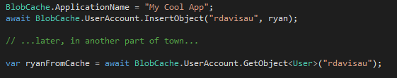
persisting data – Akavache
Akavache gives you async-friendly key-value persistence + more
Has a GetAllObjects<T>() method
Facilitates caching and expiry: GetOrFetchLatest(string key, Func<Task<T>, DateTimeOffset expiry)
Add encryption using this one simple trick [link]
This tutorial shows you how to do the same using a randomly generated encryption key stored in the keychain (rather than relying on user input) [link] this implementation assumes all inputs (serialised values) will be under the (block size – padding length: 256 – 11 = 245 bytes), If you are storing larger payloads you can use the `CreateEncryptedData` method on iOS and a technique like [this] on android

Slide 37

super duper animations - lottie
Lottie renders Adobe After Effects animations exported as json with Bodymovin, giving you high performance animations for little effort
Support for iOS and Android natively, or via Xamarin.Forms
Many animations available at www.lottiefiles.com for inspiration
Great for keeping onboarding flows simple but impressive

Slide 38
cross platform apis with no fuss - essentials
Xamarin.Essentials provides easy access to cross-platform APIs for mobile applications.
Accelerometer
App Information
Battery
Clipboard
Compass
Connectivity
Data Transfer (Share)
Device Display Information
Device Information
Email
File System Helpers
Flashlight
Geocoding
Geolocation
Gyroscope
Launcher
Magnetometer
MainThread
Maps
Open Browser
Orientation Sensor
Phone Dialer
Power
Preferences
Screen Lock
Secure Storage
SMS
Text-to-Speech
Version Tracking
Vibrate
If you like interfaces, try Essential.Interfaces too!

Slide 39
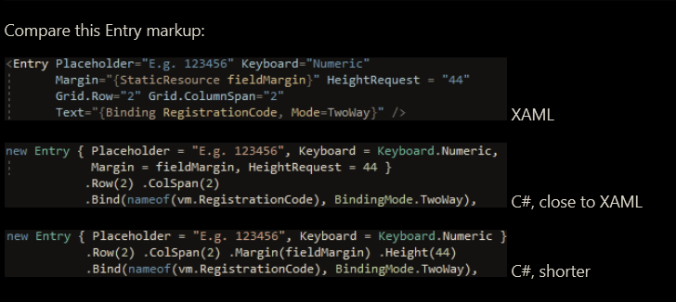

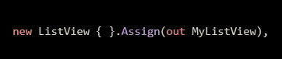
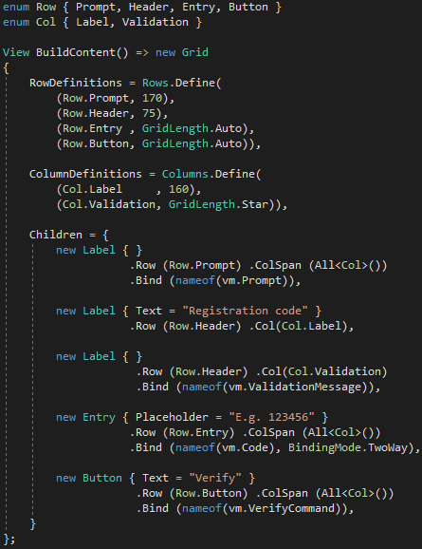
y even xaml am I rite
CSharpForMarkup is a small set of extensions designed to make writing Forms UI in code fluent and more declarative.
XAML
C# (XAML-like)
C# (concise)
Simple helpers that make coded-ui life easier:
Execute code inline
Assign controls inline
Enum-based row/cols

Slide 40

Resource roundup

Slide 41
docs/learning
Xamarin Docs https://docs.microsoft.com/en-us/xamarin/
Xamarin University https://university.xamarin.com
Books
Mastering Xamarin.Forms - https://www.packtpub.com/application-development/mastering-xamarinforms-second-edition
Xamarin in Action - https://www.manning.com/books/xamarin-in-action
You, I and ReactiveUI - https://kent-boogaart.com/you-i-and-reactiveui/
Creating Mobile Apps with Xamarin.Forms - https://docs.microsoft.com/en-us/xamarin/xamarin-forms/creating-mobile-apps-xamarin-forms/

Slide 42
(social) media
Xamarin MVP List https://twitter.com/kwlothrop/lists/xamarin-mvps
Public Xamarin Slack https://xamarinchat.herokuapp.com/
Planet Xamarin – blog aggregation https://www.planetxamarin.com/
Xamarin Gitter channels
iOS/MacOS: xamarin/xamarin-macios
Android: xamarin/xamarin-android
Forms: xamarin/Xamarin.Forms
Subscribe to the Weekly Xamarin Newsletter! http://www.weeklyxamarin.com

Slide 43
frameworks/libraries
MVVM
MvvmCross – https://github.com/MvvmCross/MvvmCross - Popular cross-platform MVVM library, Native/Forms
ReactiveUI – https://github.com/reactiveui/ReactiveUI - Reactive Extensions and FRP principles, Native/Forms
MVVM Light Toolkit – http://www.mvvmlight.net/ - Light MVVM, Native/Forms
Prism - https://prismlibrary.github.io/docs/ - Forms
FreshMvvm - https://github.com/rid00z/FreshMvvm – Forms
Libraries from the previous section
Akvache - https://github.com/akavache/Akavache - An asynchronous, persistent key-value store
Refit - https://github.com/paulcbetts/refit - The automatic type-safe REST library for Xamarin and .NET
Lottie - https://github.com/martijn00/LottieXamarin - Beautiful animations in mobile apps
Xamarin.Essentials - https://docs.microsoft.com/en-us/xamarin/essentials/ - Cross platform APIs for mobile
CSharpForMarkup - https://github.com/VincentH-Net/CSharpForMarkup - Fluent, declarative coded UI for XF

Slide 44
frameworks/libraries
(continued)
Library Roundups
Awesome Xamarin - https://github.com/XamSome/awesome-xamarin
Awesome Xamarin.Forms - https://github.com/jsuarezruiz/awesome-xamarin-forms
Goodlooking Xamarin.Forms - https://github.com/jsuarezruiz/xamarin-forms-goodlooking-UI

Slide 45
game dev
UrhoSharp
UrhoSharp [repo] https://github.com/xamarin/urho
Docs [official Xamarin documentation] https://docs.microsoft.com/en-us/xamarin/graphics-games/urhosharp/
Introduction to UrhoSharp presentation https://ryandavis.io/introduction-to-urhosharp/
Virtual/Mixed Reality Apps with C# [Build 2017 session] https://channel9.msdn.com/Events/Build/2017/T6052
Urho3d [official website] https://urho3d.github.io/

Slide 46
ci/cd
App Center
appcenter.ms [official website] https://appcenter.ms/
Docs [official Xamarin documentation] https://docs.microsoft.com/en-us/appcenter/
Introduction to Visual Studio App Center presentation https://ryandavis.io/introduction-to-visual-studio-app-center/
Azure DevOps
Step by step guides for setting up Xamarin Builds [james montemagno’s blog posts] https://montemagno.com/tag/continuous-integration/
Misc
Mobile.BuildTools [helper library for CI tasks and Xamarin Projects] https://github.com/dansiegel/Mobile.BuildTools

Slide 47
native platforms
iOS
Ray Wenderlich’s site - http://www.raywenderlich.com/
iOS Dev Weekly - https://iosdevweekly.com/
iOS Dev Center [apple’s own] - https://developer.apple.com/ios/
Droid
developer.android.com [it’s official] - http://developer.android.com/index.html
+ approximately 999,999,999,999 courses on Pluralsight

Slide 48
podcasts/videos
The Xamarin Show - https://channel9.msdn.com/Shows/XamarinShow
Merge Conflict - https://www.mergeconflict.fm
Gone Mobile - https://www.gonemobile.io

Slide 49
questions / thanks

